Slide 1
UNIT – III
Conducting an IT Infrastructure Audit for Compliance

Slide 2
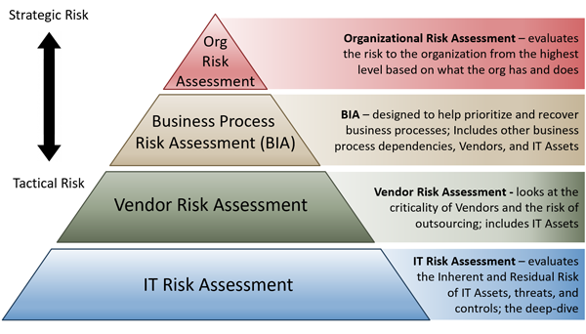
Identifying the Minimum Acceptable Level of Risk

Slide 3
security baselines
Every organization faces security threats. However, the types of security threats that are of most concern to one organization can be completely different from another organization. I.E an e-commerce company may focus on protecting its Internet-facing web apps, while a hospital may focus on protecting confidential patient information.
The one thing that all organizations have in common is a need to keep their apps and devices secure. These devices must be compliant with the security standards (or security baselines) defined by the organization.

Slide 4
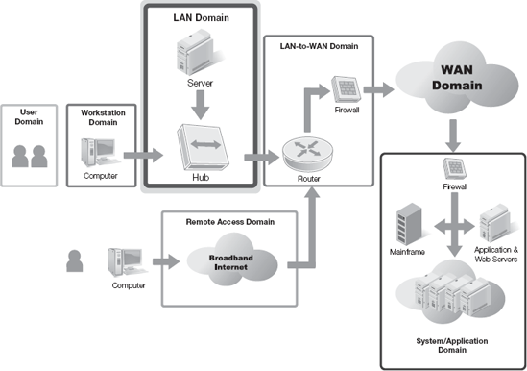
Seven domains of a typical IT infrastructure are
User Domain :
Workstation Domain
LAN Domain
LAN-to-WAN Domain
WAN Domain
Remote Access Domain
System/Application Domain

Slide 5
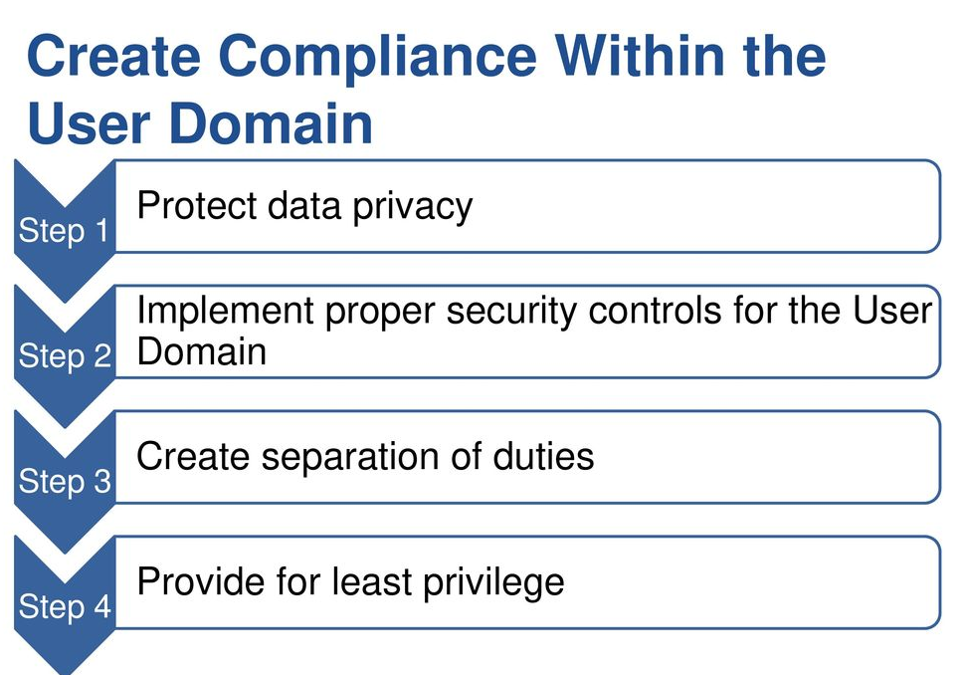
1.User Domain :
The User Domain covers all the users (of any rank) that have access to the other six domains.
RISK
User can destroy data in application (intentionally or not) and delete all
User can insert infected CD or USB flash drive into the work computer

Slide 6
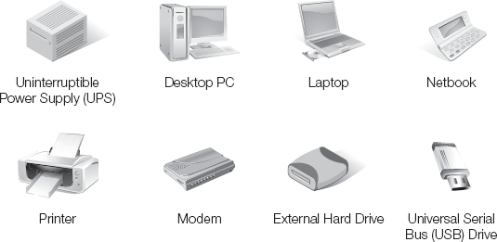
2. Workstation Domain
Devices and Components Commonly Found in the Workstation Domain

Slide 7
Compliance Law Requirements and Business Drivers
It is important that you ensure all items in the Workstation Domain are compliant. As with all domains, ensuring compliance in the Workstation Domain satisfies two main purposes:
Increases information security : Because information is a material organizational asset, and in some cases, the primary organizational asset, ensuring the security of information equates to protecting the viability of the organization. It is just as important as protecting any other major assets of the organization. A loss of any important asset will likely disrupt your organization's ability to conduct normal operations. It is important to protect your organization's ability to do business.
Reduces responsibility : If one or more attacks are successful against your organization's information, you might be liable to damages caused to third parties. If information loss or leakage causes damage to other people or organizations and the damage is a result of noncompliance, your organization might be liable for part, or all, of the damages. At the very least, disclosed successful attacks against your organization can degrade confidence in your commitment to security. An attention to compliance details and strong security can dramatically reduce your organization's exposure to liability clams.

Slide 8
3. LAN Domain
Computers that can communicate and exchange information can carry specific roles that make your organization's computing environment more efficient and practical. But, connecting computers also makes accessing your organization's information easier for both authorized and unauthorized users.
Security Controls for the LAN Domain:
Access controls for protected resources, such as printers and shared folders
Communication controls to limit the spread of malicious software
Anti-malware software on all computers in the LAN Domain to detect and eradicate malware
Recovery plans, including backups, for all computers and devices in the LAN Domain
Procedures to control configuration changes
Monitoring tools and other detective controls to help detect suspicious LAN Domain activity
Software patch management for all computers and devices in the LAN Domain

Slide 9
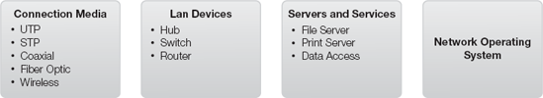
Devices and Components Commonly Found in the LAN Domain
The four main types of components in the LAN Domain include:
Connection media—The adapters and wires (sometimes) that connect components together in the LAN Domain. Not all connection methods use wires. Wireless devices use radio waves to transmit data instead of wires. So, connection media includes wireless adapters.
Networking devices—The hardware devices that connect other devices and computers using connection media.
Server computers and services devices—The hardware that provides one or more services to users, such as server computers, printers, and network storage devices.
Networking services software—The software that provides connection and communication services for users and devices.

Slide 10
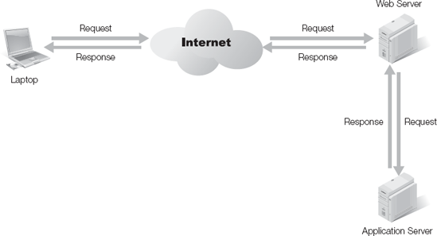
4. LAN and WAN Domain
The purpose of the LAN-to-WAN Domain is to provide stable and controlled access from LAN resources to a WAN.
The key to supporting such an environment depends on the ability to connect local resources on a local area network (LAN) to resources on another network. The most popular mechanism is the wide-area network (WAN). The purpose of the LAN-to-WAN Domain is to provide stable and controlled access from LAN resources to a WAN. You must ensure your data is secure in the LAN-to-WAN Domain as well as in all other

Slide 11
Devices and Components Commonly Found in the LAN-to-WAN Domain:
Router
Firewall
Proxy Server
Demilitarized Zone (DMZ)
Honeypots
Internet Service Provider (ISP) Connection and Backup Connection (WAN)
Dial-up
Digital subscriber line (DSL)
Cable modem
Wireless
Dedicated high-speed connection, such as a T1 or T3
Intrusion Detection System (IDS)/Intrusion Prevention System (IPS) (WAN)
Data Leakage Security Appliance(WAN)

Slide 12
5. WAN Domain
Inventory and asset management information for WAN- based servers include: Hardware information This information includes basics, such as the model and serial number.
Documentation is similar to how you'd document servers in the LAN-to-WAN Domain. Update information Servers in the WAN need to be kept up to date. This is an important step to ensure the server stays secure.
Stands for Wide Area Network and consists of the Internet and semi-private lines

Slide 13
6. Remote Access Domain
The domain in which a mobile user can access the local network remotely, usually through a VPN.
Remote access technologies give users access to an internal network via an external location. This can be done via direct dial-up or virtual private network (VPN). When dial-up is used, clients and servers have modems and access to phone lines.
When a VPN is used, the VPN server has a public IP address available on the Internet. Clients access the Internet, and then use tunnelling protocols to access the VPN server.

Slide 14
Risk Commonly Found in the Remote Access Domain
Communication circuit outage can deny connection.
Remote communication from office can be unsecured.
VPN tunneling between remote computer and ingress/egress router can be hacked.

Slide 15
7. System / Application Storage Domain
This domain is made up of user-accessed servers such as email and database
The System/Application Domain includes all system and application software-related issues. The software includes anything that collects, accesses, and stores information and can include system software running on servers and application software running on servers and workstations (referred to as end-user software).
Maintaining systems and software is the best way to mitigate risks in this domain. Allowing software to remain unpatched allows any hacker to compromise a system.
Risk:
A fire can destroy primary data
A DOS attack can cripple the organization’s email
A database server can be attacked by SQL injection, corrupting the data

Slide 16
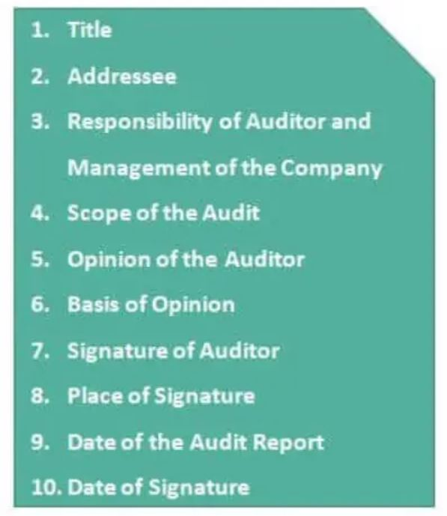
IT Infrastructure Audit Report

